Slide 1
Project 4
Steam game reviews – natural language processing
Eric Hansen
Flatiron dS; self paced
4/3/2022

Slide 2
Background - Context
Classification of text reviews is a useful tool for many different fields and is an ideal application of Natural Language Processing (NLP) techniques within Machine Learning/Deep Learning.
We investigate reviews of video games on the Steam platform (a digital distribution service and storefront developed by Valve). Launched in 2003, users can view ratings and reviews, and purchase and download games.
In 2017, Steam earned $4.3 billion in sales.
As of March 29, 2022, Steam reports over 27 million concurrent users at peak logged in to their service, with over 120 million total users.

Slide 3
Background - Stakeholders
Stakeholders in this process include (but aren't limited to)
Valve (or other digital distributors, e.g. Epic Games, Xbox Games Store, Apple App Store, Google Play),
video game developers/publishers,
video game consumers (including reviewers, critics, players, streamers, etc.),
computer hardware manufacturers (e.g., insight about game popularity could drive video card architecture)
cultural linguists (due to the nuanced and specialized vernacular exhibited by video gaming communities).

Slide 4
Background – Data
Kaggle – Steam Game Review by Luiz Martins; sourced from Steam Digital Distribution
Link to data

Slide 5
ModelS
32 NLP models, including on both CountVectorized and TF-IDF data, with/without Lemmatization: logistic regression, naïve Bayes, support vector machines, singular value decomposition, XGBoost, and multiple versions each of deep learning models LSTM and GRU (14 different DL architectures)

Slide 6
Goals
Applications
Validate new ratings (i.e. checking consistency between user text and user binary rating).
Prompt users to verify their intended binary rating if their text review seems inconsistent.
Notify distributor of potential abuse/manipulation of the rating system
Apply a rating to unlabeled reviews, acquired from off-platform sources
Generate continuous (non-binary) rating number for each review

Slide 7
Methodology Details
1) I performed Exploratory Data Analysis to identify characteristics of the data
2) I created numerous models, optimized them, and compared their performance on several metrics (f1, log-loss, AUC, accuracy)
3) I identified one of the high performing, interpretable models for word features of high importance
4) I identified the models with overall best performance on accuracy
5) I created a pickled version of the best model for portability and ease of future use
6) The conclusions: Logistic Regression on Lemmatized data categorized reviews best, with accuracy of 87%

Slide 8


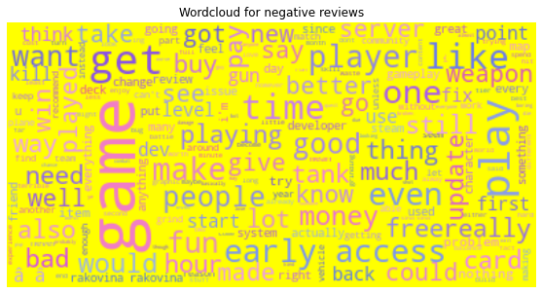
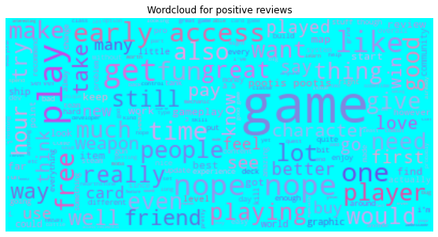
Visualizations 1 – Word Cloud of frequently used words
Highly used words for both positive and negative reviews are shown
Commonly used words to describe games appear in both positive and negative reviews, but when there is difference, this can help develop insight

Slide 9

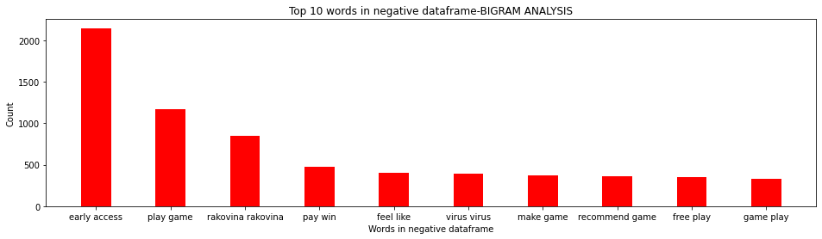
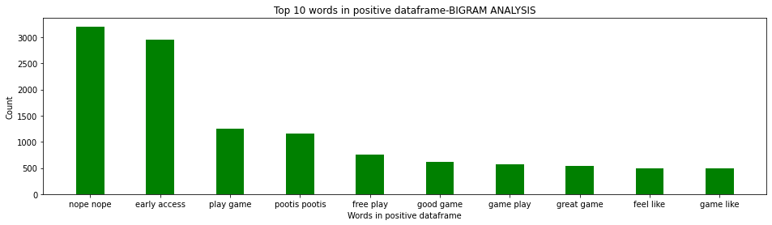
Visualizations 2 – Bigram Histogram
Most frequent bi-grams shown in histogram form

Slide 10
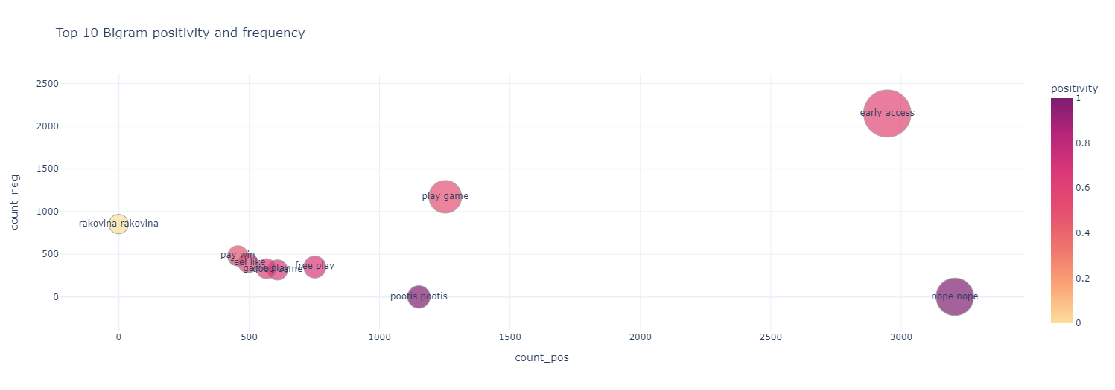
Visualizations 3 – Bigram Bubbleplot
Positive count on x-axis
Negative count on y-axis
Overall frequency is size
Color shows positivity
Interactive version available

Slide 11
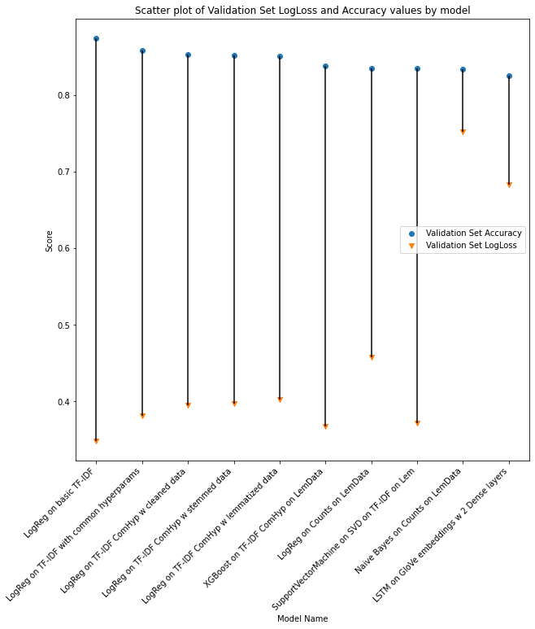
Model Results
32 Models were produced
Of these, the top 10 highest-accuracy (on validation set) models are presented
Highest Accuracy Model is Logistic Regression on TF-IDF, with score of 87%
(Industry best is mid-90%, but that doesn’t factor in so much slang/vernacular)
Naïve Bayes is also investigated further for its interpretability

Slide 12
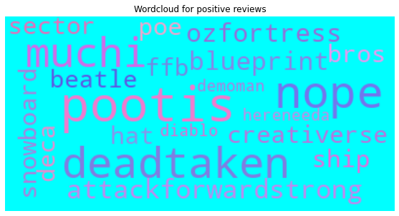
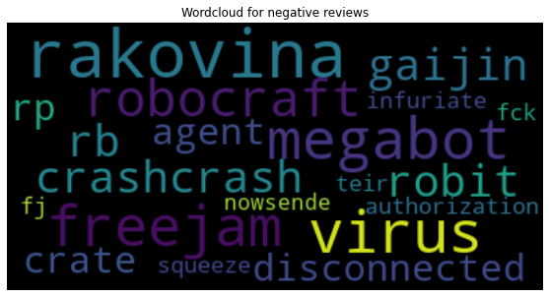
Naïve Bayes: Word Salience
The model that performed Naïve Bayes prediction on count vectorized data had respectable accuracy, but also is notable because the word weights are accessible and interpretable
Upon word salience investigation, relative word importance sheds some illumination
“Pootis” has a high correlation with positive reviews. It is a phrase from a game called Team Fortress; this is a phrase very localized to video gaming.
“Rakovina” (a Slavic word for cancer) has a strong correlation with negative review. However, as above, this word is unlikely to appear in “usual” or pretrained models
It is possible that the high presence and influence of these unusual words caused the models that were based on pre-trained vectors (e.g. GloVe) to underperform
It is also possible that the unusual grammatical structures also contributed to the deep learning models’ lower performance.

Slide 13
Conclusions/questions
Steam reviews can be classified positive/negative with ~87% accuracy.
NLP analysis of video game reviews is nuanced due to specific vernacular to that community
Model could be extended to produce continuous “positivity” sentiment score, rather than just binary

Slide 14
Conclusions/questions
Actionable items using this model:
Validate user-generated scores
Bolster fraud/abuse checking
Incorporate generated scores into game ratings
Include off-platform reviews for more comprehensive score

Slide 15
Conclusions/questions
Potential further steps:
acquire more labeled data to further train models
use extracted observations about word frequencies over time to investigate emergent language behavior

Slide 16
Conclusions/questions
Questions?

Slide 17
Conclusions/questions
Thank you!

